Slide 1
SEMPHY01
Semiconductor Physics
Eugene Joseph M Ragasa
AY2025-2026 T1
M0L1 – Course Introduction

Slide 2
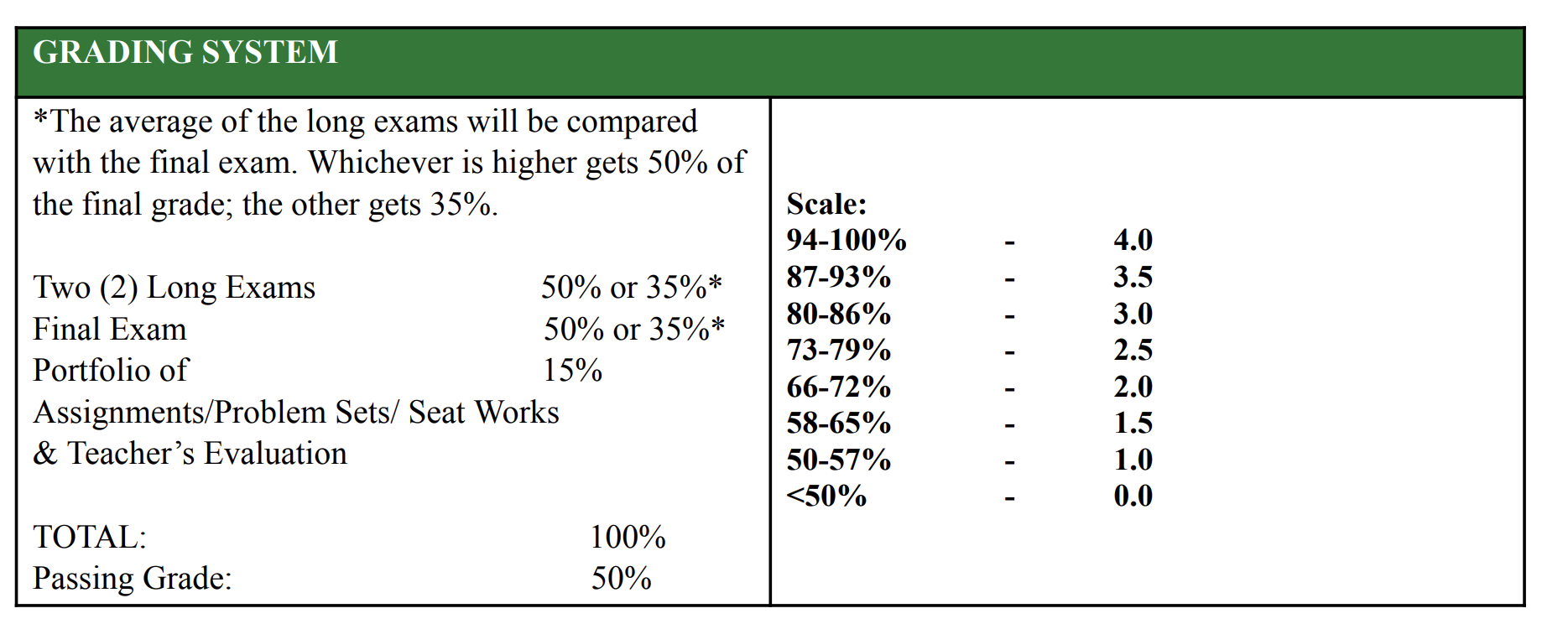
Grading System

Slide 3
Examinations
Two (2) Long Exams 50% or 35%*
Final Exam 50% or 35%*
Take home examination
Oral presentation/Oral examination

Slide 4
Problem Sets
Problems Set at every module
Expect problem sets to be typset (word, latex, markdown) SUBMITTED AS PDF.

Slide 5
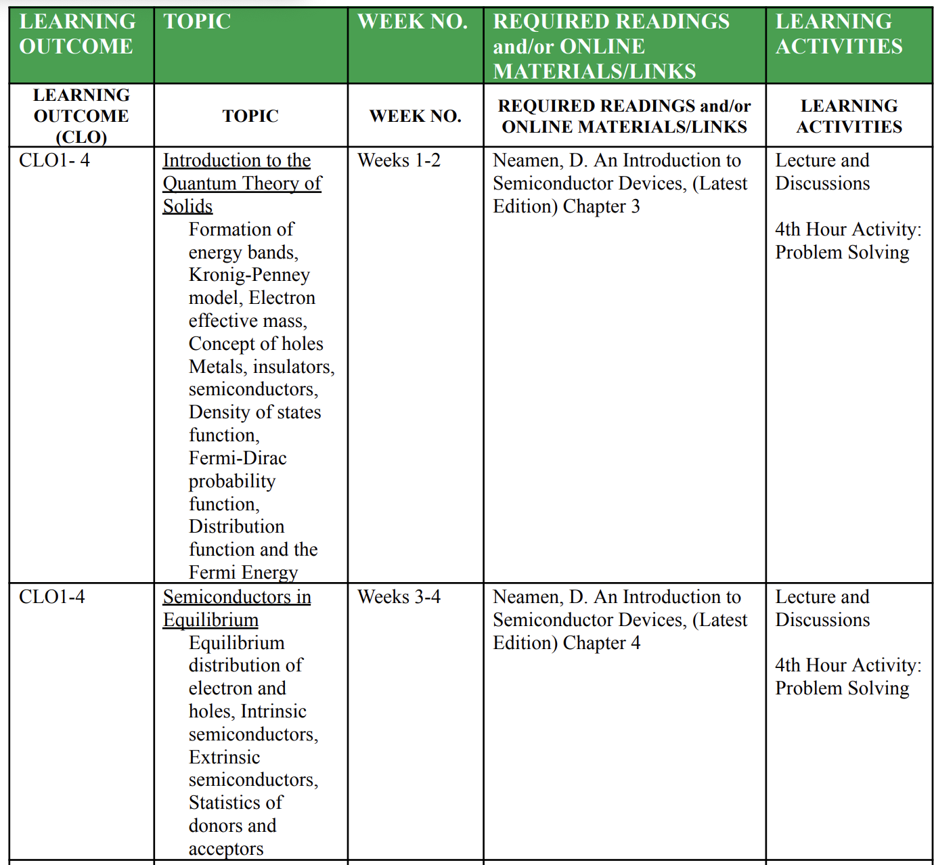
Assessment block

Slide 6
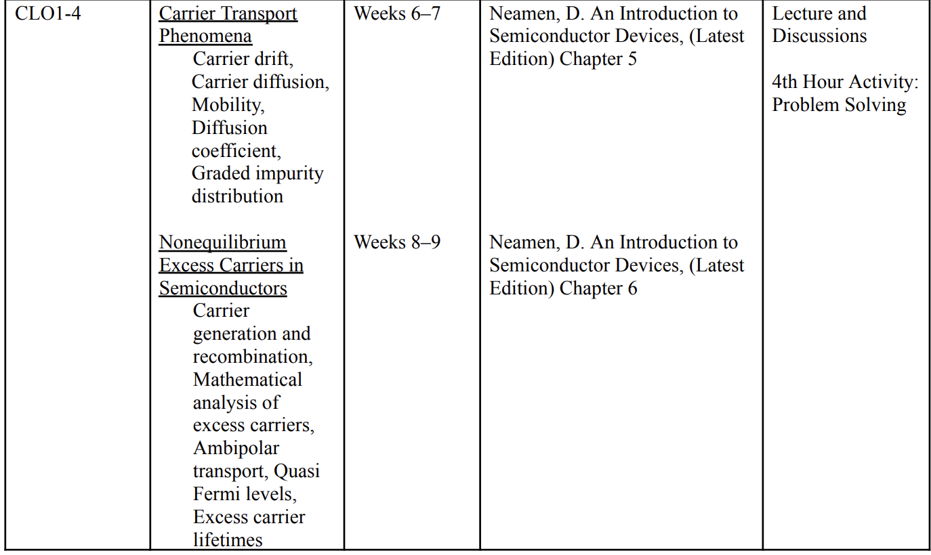
Transport Phenomena

Slide 7
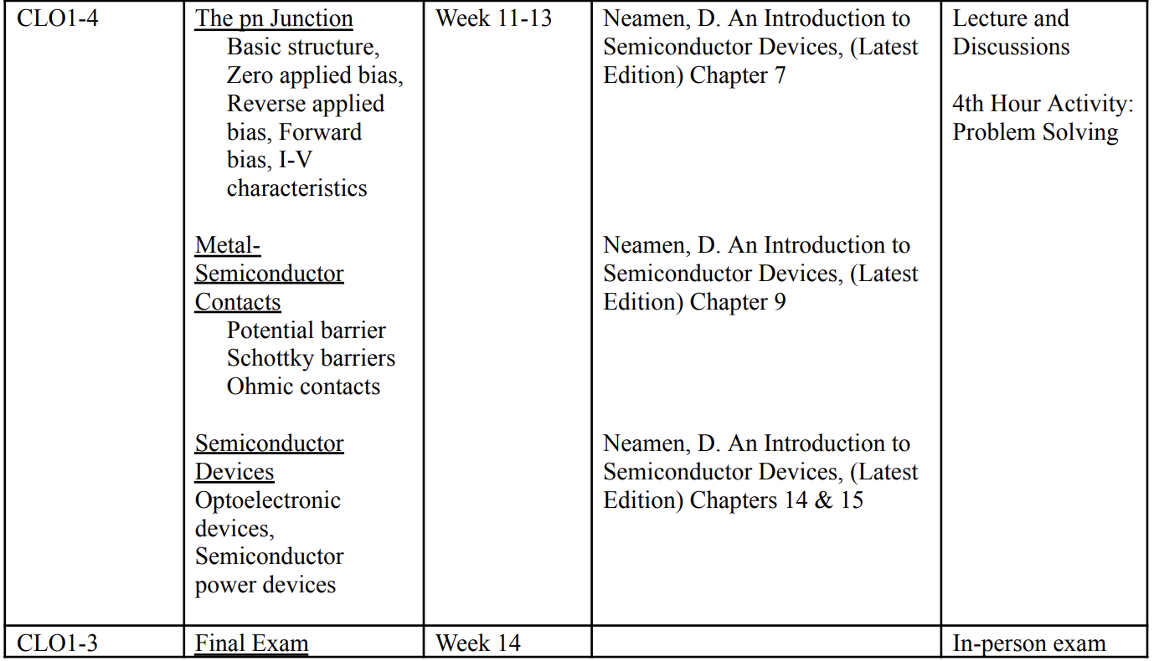

Slide 8
Textbooks
Primary Reference Source:
Neaman, Introduction to Semiconductors, 3rd Edition
Hummel, Electronic Properties of Materials, 4th Edition
Sze and Lee, Semiconductor Devices (device book), 3rd Ed
Yu and Cardona, Fundamental of Semiconductor, 4th Ed

Slide 9
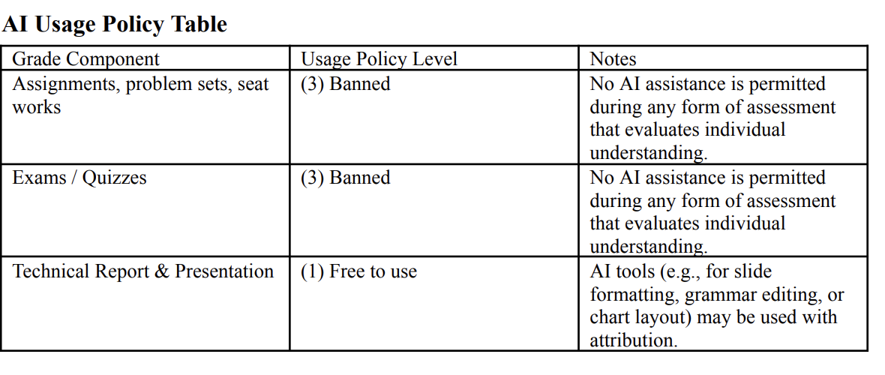
AI Policy

